Slide 1

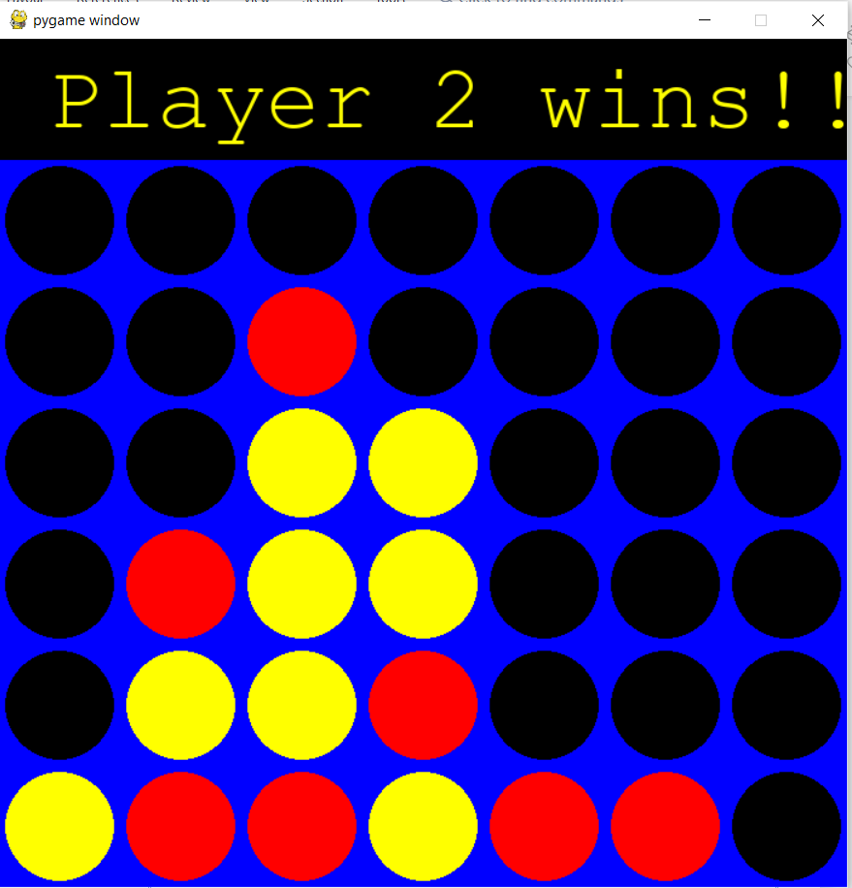
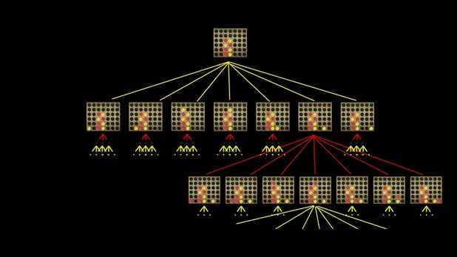
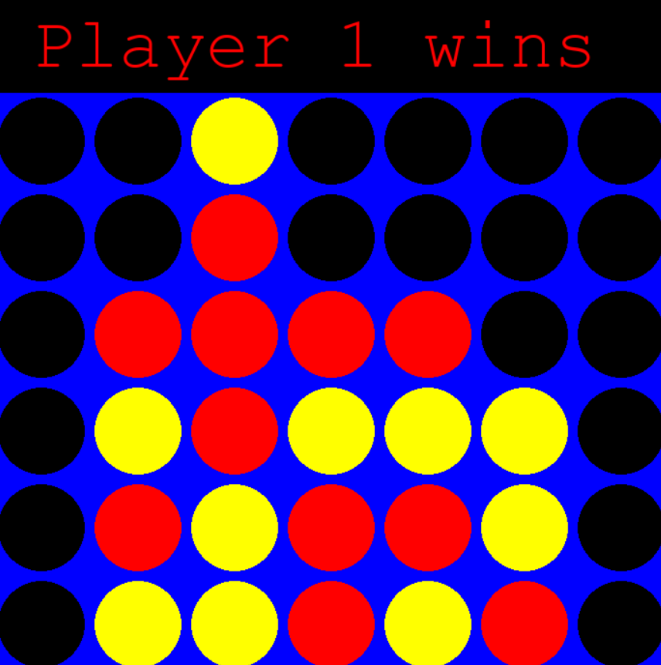
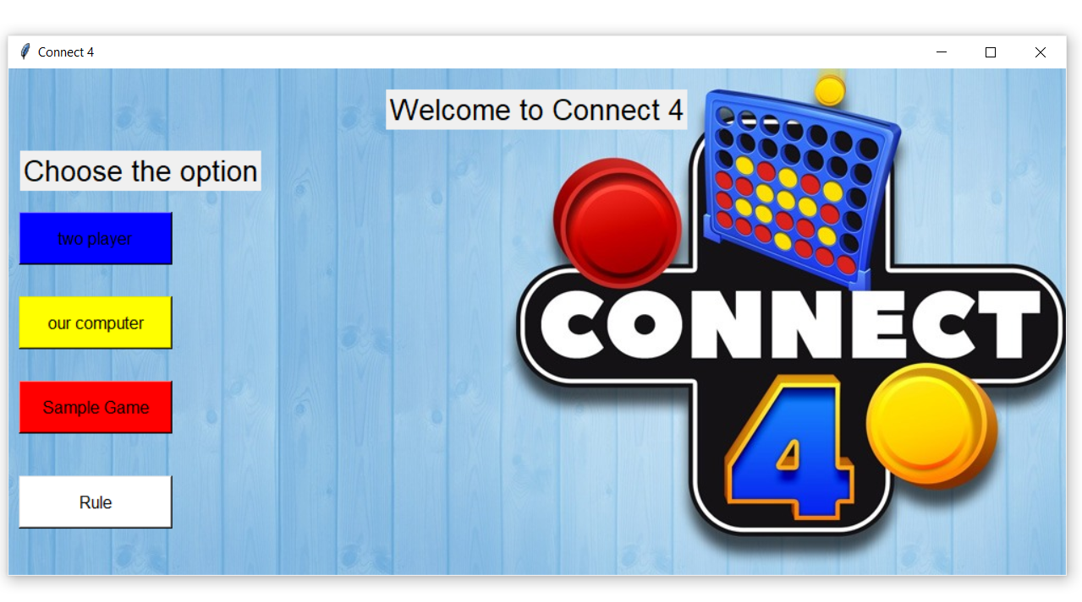
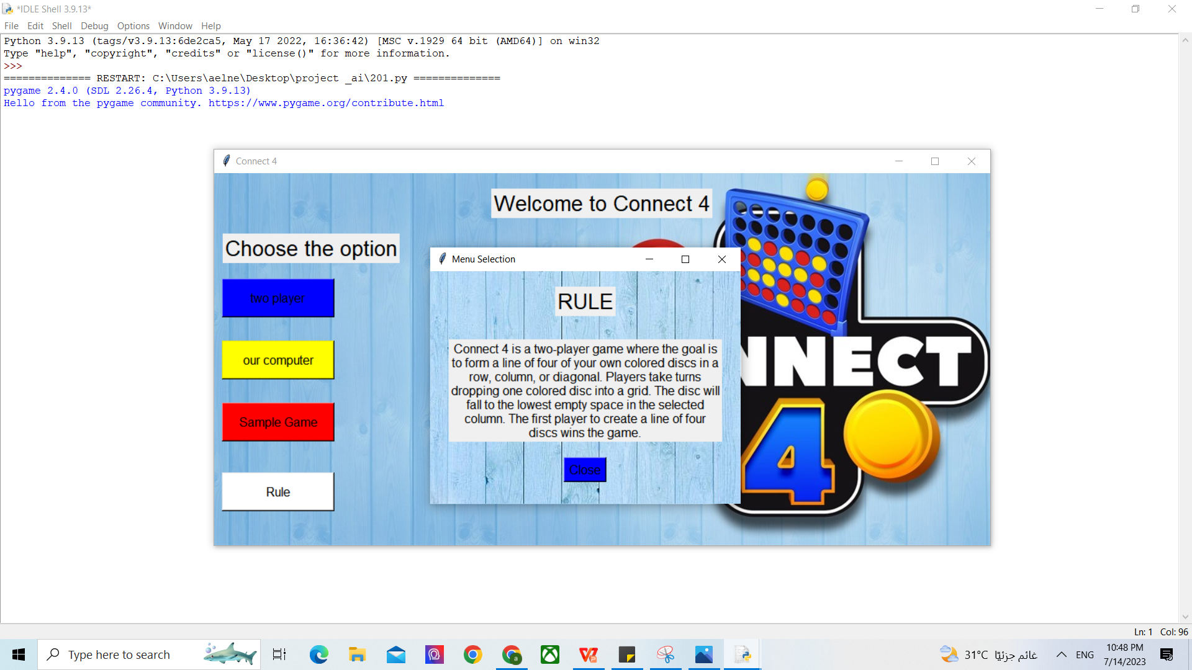
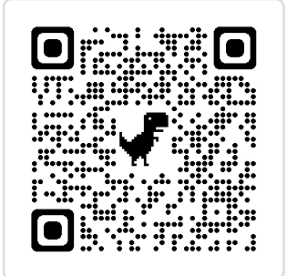
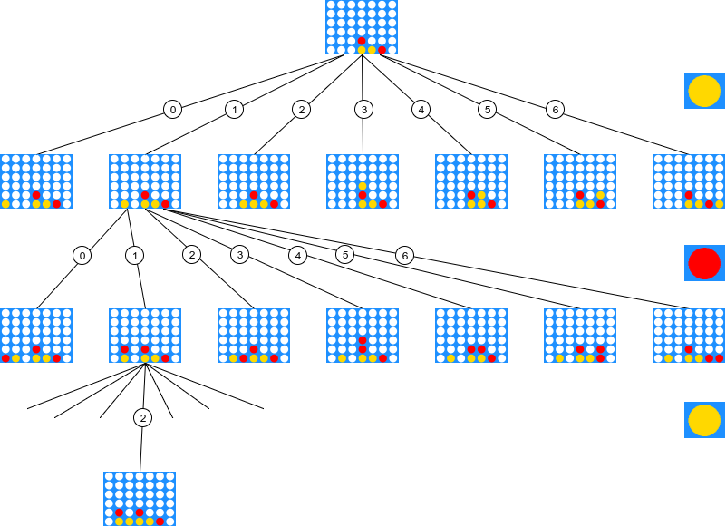
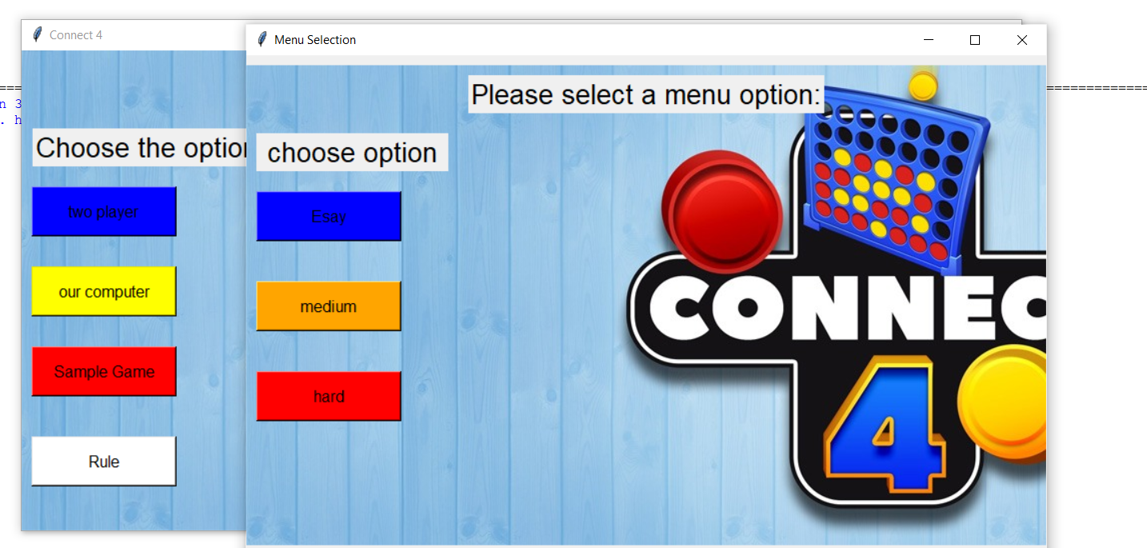


AIS201
Dr.Hala Zayed
Connect_4 Game
Introduction
Methodology
The objective of Connect 4 is to be the first player to connect four of their colored discs in a horizontal, vertical, or diagonal line on a grid of six rows and seven columns. Players take turns dropping one of their discs into any of the columns, causing it to fall to the lowest available position in that column. The discs stack up, creating a dynamic playing field that requires careful planning and anticipation. using Python Code
Minimax algorithm on the hard level:
The minimax algorithm is used in game theory and decision-making to determine the best course of action provided that the adversary plays effectively as well.
Here is how it works:
Methodology
We implement a Connect Four game with a graphical user interface (GUI) implemented using the Tkinter library. The game has three levels (easy, medium, hard), and there is also an option to play a typical game against an AI opponent or with another player or play Ai against Ai.
1 - The random algorithm at an easy level:
A random algorithm is a simple approach to playing Connect 4, requiring minimal strategy and experimentation. It's suitable for beginners.
Here is how it works:
The computer player selects a random column to drop its token into, without considering any strategic decision-making. chances of winning.
2- alpha-beta pruning algorithm at the medium level:
The alpha-beta pruning algorithm is a powerful technique for searching game trees and finding optimal moves in games with multiple alternative moves. It reduces the search tree size and eliminates the need to analyze all potential game pathways.
Here is how it works:
Conclusion
Fig 2: Minimax Game Tree
Results
In conclusion, Connect Four GUI offers three difficulty levels: easy, medium, and hard, using different algorithms and strategies for a unique gameplay experience. It enhances accessibility, showcases AI potential, and encourages innovation in intelligent gameplay systems. For future work, We will use an algorithm at the easy level instead of a random algorithm that makes the computer player selects a random column to drop its token into, without considering any strategic decision-making.
level Game | Algorithms
Esay | randomly
Medium | alpha-beta
Hard | Minimax
You can play with Ai or another player for each level.
Github Link
Rule: How to play game
GUI for playing Connect Four offers three difficulty levels: easy, medium, and hard
Team
Fig 1: Alpha-Beta Pruning Game Tree
Aya Fouda
Nada Hussain

